Slide 1
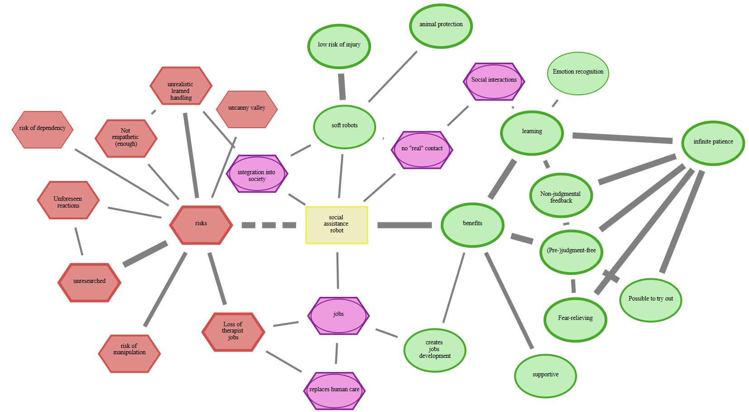
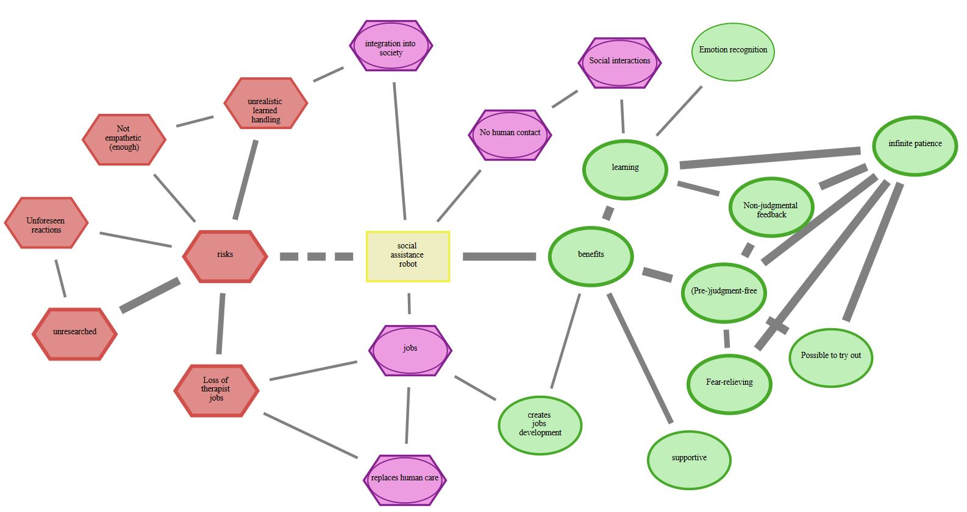


Rigid RR
Soft RR
Draw CAM
Adjust drawn CAM
D
N
Rigid SAR
Soft SAR
$$C_{2}$$
$$C_{1}$$
“deleted” (D)
“new” (N)
Added (N) and deleted (O) concepts

